Slide 1


Chapter 10
ESTABLISHING REQUIREMENTS

Slide 2
Overview
The importance of requirements
Different types of requirements
Data gathering for requirements
Data analysis and presentation
Task description: Scenarios Use Cases Essential use cases
Task analysis: HTA

Slide 3
Establishing requirements
What do users want? What do users ‘need’?
Requirements need clarification, refinement, completion, re-scoping
Input: Requirements document (maybe)
Output: stable requirements
Why ‘establish’?
Requirements arise from understanding users’ needs
Requirements can be justified & related to data

Slide 4
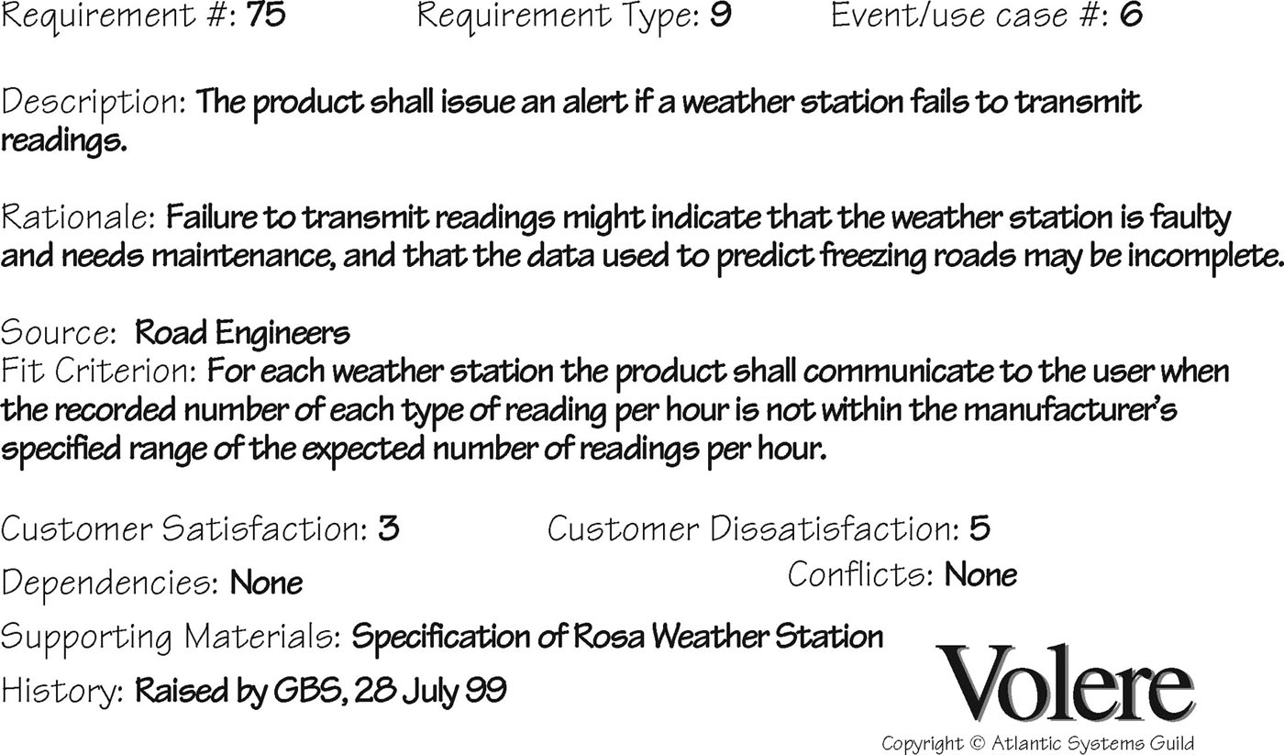
Volere shell
Notes:
A requirement is a statement about an intended product, that it says what it should do or how it should perform.
Requirements can be expressed using a format called an atomic requirements shell from the Volere process (Robertson and Robertson, 2013). The shell requires quite a bit of information about the requirement itself, including something called a fit criterion, which is a way of measuring when the solution meets the requirement. In Chapter 9 we emphasize that the need to establish specific usability criteria for a product early on in development, and this part of the shell encourages this.
Interaction design involves understanding the functionality required and the constraints under which the product should operate or be developed, hence we are concerned with a wide range of requirements.

Slide 5
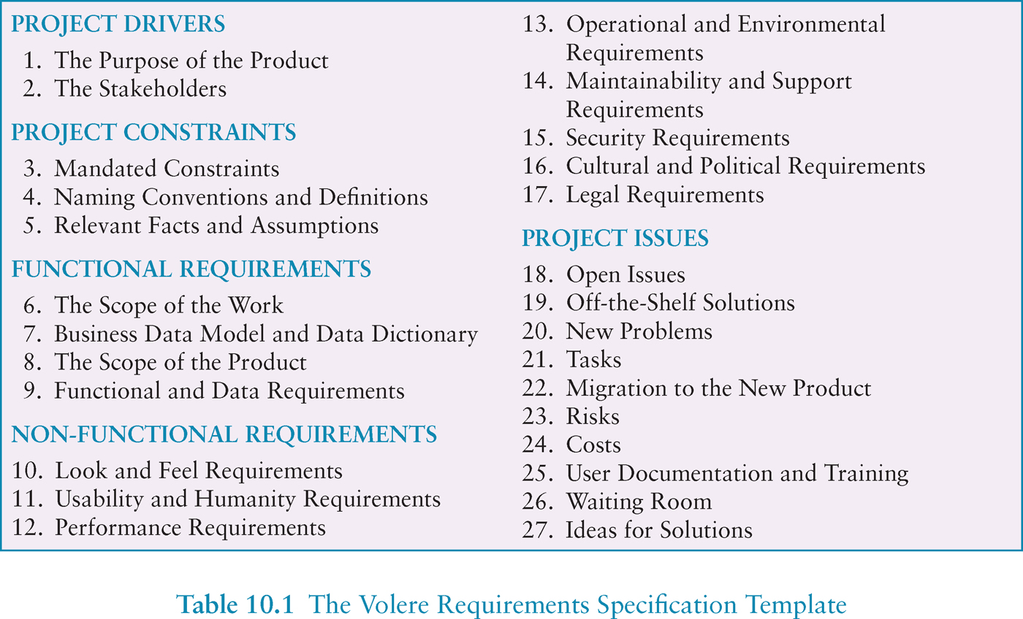
Volere requirements template
Notes:
This table provides an alternative (long list) of requirements that might be considered. Non-functional requirements say what constraints there are on the system and its development.
Functional requirements capture what the product should do: (new video game) It should be challenging for a range of user abilities. Non-functional: (new game) it can run on a variety of platforms.
(manufacturing robot - functional) it should be able to accurately place and weld together the correct pieces of metal. (Non-functional) It should be quiet to some number of decibels, and should take up a specific square foot of space on the factory floor.

Slide 6
Different kinds of requirements
Functional:
What the system should do
(Non-functional: security, response time...)
Data:
What kinds of data need to be stored?
How will they be stored (e.g. database)?
Notes:
If a system is under consideration for trading of commodities and stock, then the data must be up-to-date and accurate, and is likely to change many times a day. In the personal banking domain, data must be accurate, must persist over many months and probably years, and there is likely to be a lot of it.

Slide 7
Different kinds of requirements
Environment or context of use:
physical: dusty? noisy? vibration? light? heat? humidity? …. (e.g. ATM)
social: sharing of files, of displays, in paper, across great distances, synchronous, privacy for clients
organisational: hierarchy, IT department’s attitude and remit, user support, communications structure and infrastructure, availability of training
Notes:
ATM operates in a crowded environment, public physical environment, therefore using a speech interface is therefore likely to be problematic.
Sharing: does it need to be synchronous – does everyone need to be viewing the data at once? Or asynchronous – two people authoring a report take turns editing it?
Organizational: technical environment – what technologies will the product run on or need to be compatible with, and what technology limitations might be relevant? Will it need to be integrated with SAP

Slide 8
Different kinds of requirements
Users: Who are they?
Characteristics: nationality, educational background, attitude to computers
System use: novice, expert, casual, frequent
Novice: prompted, constrained, clear
Expert: flexibility, access/power
Frequent: short cuts
Casual/infrequent: clear menu paths
Notes:
In chapter 9, we talked about the importance of user’s abilities and skills. Other characteristics include demographics, nationality, education background, preferences, personal circumstances, physical and mental disabilities and so on.
Users may be a novice, expert, or casual, or a frequent user. For example, novice may require step-by-step instructions, probably with prompting, and a constrained interaction backed up with clear information. An expert, may require a flexible interaction with more wide-ranging powers of control. The collection of these characteristics for a typical user is called a user profile. Any one product may have several different user profiles.

Slide 9


What are the users’ capabilities?
Humans vary in many dimensions:
size of hands may affect the size and positioning of input buttons
motor abilities may affect the suitability of certain input and output devices
height if designing a physical kiosk
strength - a child’s toy requires little strength to operate, but greater strength to change batteries
disabilities (e.g. sight, hearing, dexterity)

Slide 10
Personas
Capture a set of user characteristics (user profile)
Not real people, but synthesised from real users
Should not be idealised
Bring them to life with a name, characteristics, goals, personal background
Develop a small set of personas with one primary
Notes:
In order to bring user profiles to life, Cooper et al in 1999 developed the concept of a “persona”
Personas are rich descriptions of typical users of the product under development that the designers can focus on and design the product for. The don’t describe real people, but are realistic rather than idealized.
Any one persona represents a synthesis from a number of real users who have been involved in data gathering. Each personal is characterized by a unique set of goals relating to the particular product under development, rather than a job description or job role. Apart from goals, a persona will include a description of the user’s skills, attitudes, tasks and the environment.

Slide 11
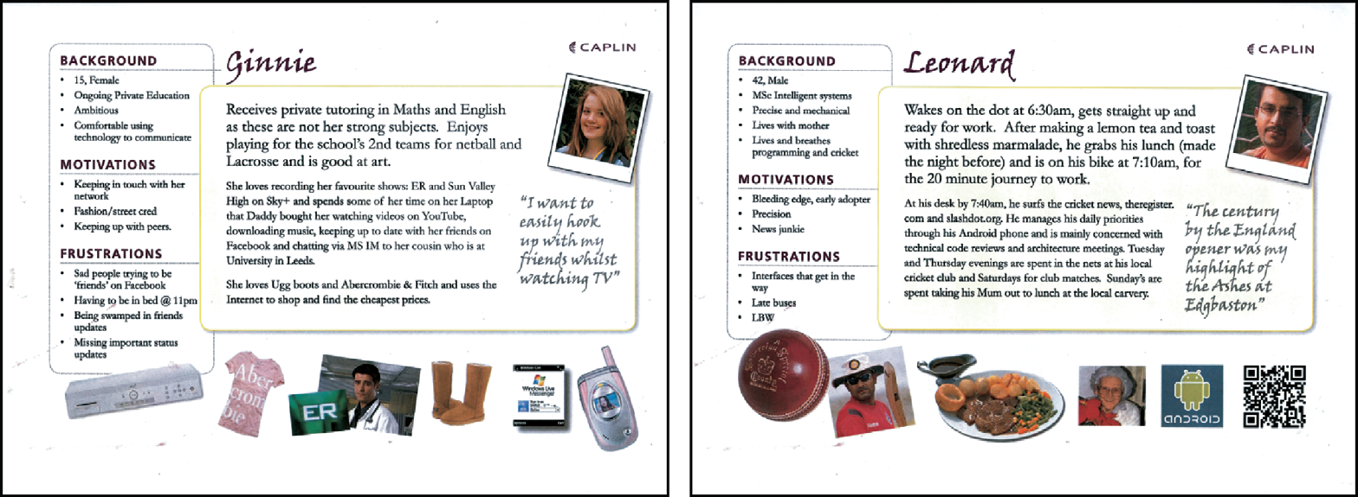
Example Persona
Notes:
Each persona has a name, often a photograph, and some personal details such as what they do in their leisure time. In addition of precise, credible details that helps designers to see the personas as real potential users, and hence as people they can design for.
Usually a product will require a small set of persona who represent a large section of the intended user group. Personas are used widely in industry, and have proved to be a powerful way to communicate user characteristics and goals to designers and developers, and have even transferred to advertisements.

Slide 12
Data gathering for requirements
Interviews:
Props, e.g. sample scenarios of use, prototypes, can be used in interviews
Good for exploring issues
Development team members can connect with stakeholders
Focus groups:
Group interviews
Good at gaining a consensus view and/or highlighting areas of conflict
But can be dominated by individuals
Notes:
The overall purpose of data gathering in the requirements activity is to collect sufficient, relevant, and appropriate data so that a set of stable requirements can be produced. In chapter 7, you saw what were common data gathering methods. Here, we briefly revisit them to study how they can be used in the requirements gathering and establishing requirements process.

Slide 13
Data gathering for requirements
Questionnaires:
Often used in conjunction with other techniques
Can give quantitative or qualitative data
Good for answering specific questions from a large, dispersed group of people
Researching similar products:
Good for prompting requirements

Slide 14
Data gathering for requirements
Direct observation:
Gain insights into stakeholders’ tasks
Good for understanding the nature and context of the tasks
But, it requires time and commitment from a member of the design team, and it can result in a huge amount of data
Indirect observation:
Not often used in requirements activity
Good for logging current tasks

Slide 15
Data gathering for requirements
Studying documentation:
Procedures and rules are often written down in manuals
Good source of data about the steps involved in an activity, and any regulations governing a task
Not to be used in isolation
Good for understanding legislation, and getting background information
No stakeholder time, which is a limiting factor on the other techniques

Slide 16
Contextual Inquiry
An approach to ethnographic study where user is expert, designer is apprentice
A form of interview, but
at users’ workplace (workstation)
2 to 3 hours long
Four main principles:
Context: see workplace & what happens
Partnership: user and developer collaborate
Interpretation: observations interpreted by user and developer together
Focus: project focus to understand what to look for
Notes:
Holtzblatt and Jones, 1993 came up with Contextual Inquiry, which is a structured approach to the collection and interpretation of data from fieldwork with the intention of building a software-based product. The most typcial format for contextual inquiry uses the apprenticeship model, the designer works as an apprentice to the user, and the user is considered as an expert. The most typical format for the contextual inquiry is a contextual interview, which is a combination of observation, discussion and reconstruction of past events.
Context: Emphasizes the importance of going to the workplace and seeing what happens.
Partnership: Developer and User should collaborate in understanding the work. In a traditional interviewing or workshop situation, the interviewer or workshop leader is in control, but in contextual inquiry the spirit of partnership means that the undersnding is developed through cooperation.
Interpretation: The oberservation must be interpreted in order to be used in design, and this interpretation should also be developed in cooperation between the user and developer.
Focus: Keeping the data gathering focused on your goals. In contextual inquiry, as in an unstructured interview, for example, it is easy for the discussion to wander off target. The help avoid this, a project focus is extablished to guide the interviewer, which will then be augmented by the individual’s own focus that arises from their perspective and background.
Each developer in the team will do at least one contextual inquiry session.
In one research, with mercedes benz, contextual inquiry was used over a period of six weeks to investigate how car drivers interact with the multi-function rotating button often found in the center of the car dashboard. The study highlighted that comfort, safety, and security factors were mentioned most often, while visual and haptic aesthetics were not mentioned by any participants. These findings informed the design of the new in-vehicle information systems.

Slide 17
Data gathering guidelines
Focus on identifying the stakeholders’ needs
Involve all the stakeholder groups
Involve more than one representative from each stakeholder group
Use a combination of data gathering techniques
Support the process with props such as prototypes and task descriptions
Notes:
Identified stakeholders may be achieved by studying behaviors and support tools, or by looking at other products, such as a competitor’s products or an early release of a product under development.
It is very important to involve all stakeholders in the group and its association. In one case with a large distribution and logistics company, a system was developed by interviewing warehouse staff, clerical and managerial people, but when the system went live, production dropped by 50%. Because, the bottleneck was that when developing the system, the warehouse supplier was not involved in the design and development of the system, and it was incompatible with them. No one had asked them how they worked, and the new system was incompatible with their working routines.
Involving only one representative from each stakeholder in the group is not enough, especially if the group is very large. Everyone involved in the data gathering will have their own perspectives on the situation, the task and their job, and how they interact with them. If you only involve one representative stakeholder then you will only get a narrow view.
Support the data gathering sessions with suitable props, such as task descriptions and prototypes if available. Since the requirements activity is iterative, prototypes or descriptions generated during one session may be reused or revisited in another with the same or different set of stakeholders.
Using props may also help to jog people’s memory and act as a focus for discussions.

Slide 18
Data interpretation and analysis
Start soon after data gathering session
Initial interpretation before deeper analysis
Different approaches emphasize different elements e.g. class diagrams for object-oriented systems, entity-relationship diagrams for data intensive systems

Slide 19
Task descriptions
Scenarios
an informal narrative story, simple, ‘natural’, personal, not generalizable
Use cases
assume interaction with a system
assume detailed understanding of the interaction
Essential use cases
abstract away from the details
does not have the same assumptions as use cases
Notes:
Introduce three common description types for tasks: scenarios, use cases and essential use cases (sometimes referred to as task cases). Each of these may be used to describe existing tasks or envisioned tasks with a new product.
A scenario is an “informal narrative description” (Carroll, PSU, 2000). It decribes human activities or tasks in a story that allows exploration and discussion of contexts, needs and requirements. It does not necessarily describe the use of software or other technological support to achieve a task. Here, using the vocabuilary and phrasing of users means that the scenarios can be understood by the stakeholders and they are able to participate fully in the development process. Idea behind the developed scenario is to understand why people do the things they do, and what they are trying to achieve in the process, and this allows us to focus on human activity with existing and future system rather than interaction with technology. It’s a good idea for a scenario to incorporate the context, constraints, irritators, facilitators, and the usability and user experience goals. When combined with a persona, this kind of scenario can improve the develpers appreciation of the user experience.
Use cases also focus on user goals, but the emphasis here is on the user-system interaction rather than the user’s task itself, with specific importance to the user (called an actor) and stresses the user’s perspective and not the system’s. The use case is trying to capture the actor’s goal in using the system. Set of actions an analyst believes to be most commonly performed by the actor/user; it represents one path through the use case, i.e. one particular set of conditions.
Essential use cases (sometimes referred to as task cases) represent abstractions from scenarios, i.e. they represent a more general case than a scenario embodied, and try to avoid the assumptions of a traditional use case. An essential use case is a structured narrative consisting of three parts: a name that expresses the overall user intention, a stepped description of user actions, and a stepped description of system responsibilities. This division between user and system responsibilities can be very helpful during conceptual design when considering task allocation and system scope, i.e. what the user is responsible for and what the system is to do.

Slide 20
Scenario for travel organizer
“The Thomson family enjoy outdoor activities and want to try their hand at sailing this year. There are four family members: Sky (10 years old), Eamonn (15 years old), Claire (35), and Will (40). One evening after dinner they decide to start exploring the possibilities. They all gather around the travel organizer and enter their initial set of requirements – a sailing trip for four novices in the Mediterranean. The console is designed so that all members of the family can interact easily and comfortably with it. The system’s initial suggestion is a flotilla, where several crews (with various levels of experience) sail together on separate boats. Sky and Eamonn aren’t very happy at the idea of going on vacation with a group of other people, even though the Thomsons would have their own boat. The travel organizer shows them descriptions of flotillas from other children their ages and they are all very positive, so eventually, everyone agrees to explore flotilla opportunities. Will confirms this recommendation and asks for detailed options. As it’s getting late, he asks for the details to be saved so everyone can consider them tomorrow. The travel organizer emails them a summary of the different options available.”
Notes:
Start: The following scenario is for a shared travel organizer was elicited in an informal interview setting. They can be used to imagine potential uses of a product as well as to capture existing behavior. They are not intended to capture a full set of requirements, but are a very personalized account, offering only one perspective. This describes how one function of the system might work: to identify potential vacation options.
End: Note that this scenario includes details about some typical users and their needs. This is the kind of information that you might glean from a requirements interview.

Slide 21
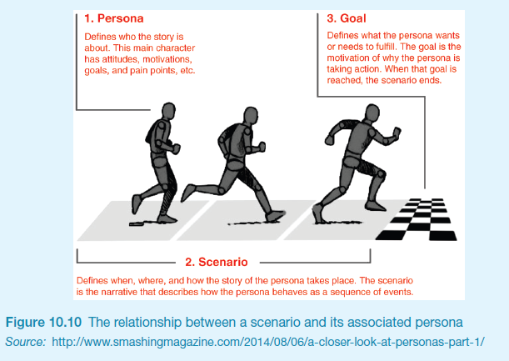
Scenarios and Personas

Slide 22
Use case for travel organizer
1. The system displays options for investigating visa and vaccination requirements.
2. The user chooses the option to find out about visa requirements.
3. The system prompts user for the name of the destination country.
4. The user enters the country’s name.
5. The system checks that the country is valid.
6. The system prompts the user for her nationality.
7. The user enters her nationality.
8. The system checks the visa requirements of the entered country for a passport holder of her nationality.
9. The system displays the visa requirements.
10. The system displays the option to print out the visa requirements.
11. The user chooses to print the requirements.
Notes:
A use case for retrieving the visa requirements using the travel organizer, with the normal course being that information about the visa requirements is available might be the above:

Slide 23
Alternative courses for travel organizer
Some alternative courses:
6. If the country name is invalid:
6.1 The system displays an error message.
6.2 The system returns to step 3.
8. If the nationality is invalid:
8.1 The system displays an error message.
8.2 The system returns to step 6.
9. If no information about visa requirements is found:
9.1 The system displays a suitable message.
9.2 The system returns to step 1.
Notes:
Other possible sequence, such as alternative course, are then listed at the bottom of the use case. Note how specific the use case is about how the user and the system will interact.

Slide 24
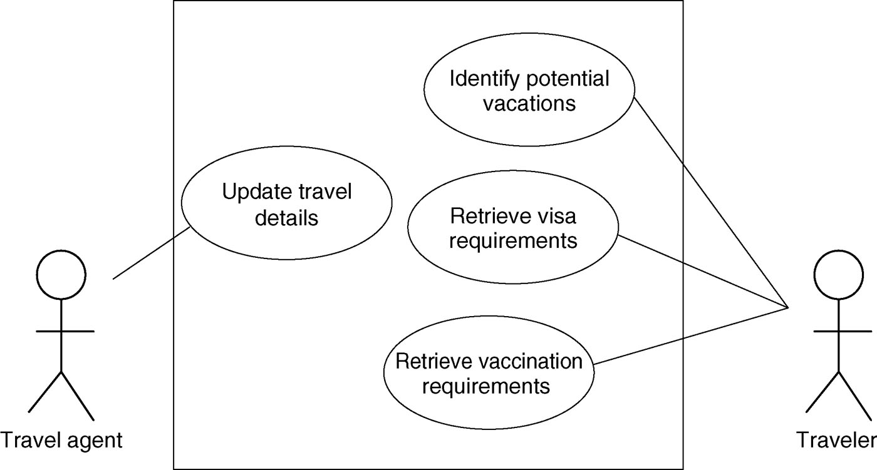
Example use case diagram for travel organizer
Notes:
Use cases may be described graphically, This figure shows the use case diagram for the “shared travel organizer”. The Travel agent actor is associated with the use case “Update travel details.” Another actor for the travel organizer is the traveler, such as the Thompson family. Actors may be associated with more than one use case, so , for example, Traveler is associated with a use case “Identify potential vacations” as well as the “Retrieve visa requirements” use case. Each use case may be associated with more than one actor, but the use case is showing the “normal course” of action for a typical actor.

Slide 25
Example essential use case for travel organizer
retrieve Visa
USER INTENTION SYSTEM RESPONSIBILITY
find visa requirements request destination and nationality supply required information obtain appropriate visa info obtain copy of visa info offer info in different formats choose suitable format provide info in chosen format
Notes:
Constantine and Lockwood (1999). Example use case based on the visa requirements example given above is shown. Structured narrative, consisting of three parts – name: that expresses the overall user intention, retrieve visa; stepped down description of the user actions; the system’s stepped down description of its responsibility. At the time of creating this essential use case, there is no commitment to a particular interaction design. I.E. Obtain appropriate visa information could mean, scanning the passport, accessing a data base of personal information based on fingerprint recognition, etc.

Slide 26
Task analysis
Task descriptions are often used to envision new systems or devices
Task analysis is used mainly to investigate an existing situation, not to envision new products.
It is important not to focus on superficial activities
What are people trying to achieve?
Why are they trying to achieve it?
How are they going about it?
Many techniques, the most popular is Hierarchical Task Analysis (HTA)
Notes:
2. Task analysis is an umbrella term that covers techniques for investigating cognitive processes and physical actions, at a high level of abstraction and in minute detail. The most widely used form of this is the HTA.
3. It involves first understanding what are people trying to achieve? Why are they trying to achieve it? And how are they going about it? From this requirements gathering phase, you might establish a HTA that includes (next page).

Slide 27
Hierarchical Task Analysis
Involves breaking a task down into subtasks, then sub-sub-tasks and so on. These are grouped as plans which specify how the tasks might be performed in practice
HTA focuses on physical and observable actions, and includes looking at actions not related to software or an interaction device
Start with a user goal which is examined and the main tasks for achieving it are identified
Tasks are sub-divided into sub-tasks
Notes:
Developed by researchers Annett and Duncan, 1967. Breaking a task down to subtasks and then sub-sub tasks and so on. These are then grouped into plans that specify how the tasks might be performed in a real situation.
HTA as with other techniques described above is user centric. HTA focuses on physical and observable actions, and includes looking at actions not related to software or an interaction device.
The starting point is a user goal, This is then examined and the main tasks associated with achieving that goal are identified.
When appropriate these tasks are sub-divided into subtasks, then the subtasks can be further divided etc, down to low-level steps of the interaction.

Slide 28
Example Hierarchical Task Analysis
0. In order to buy a DVD
1. locate DVD
2. add DVD to shopping basket
3. enter payment details
4. complete address
5. confirm order
plan 0: If regular user do 1-2-5. If new user do 1-2-3-4-5.

Slide 29
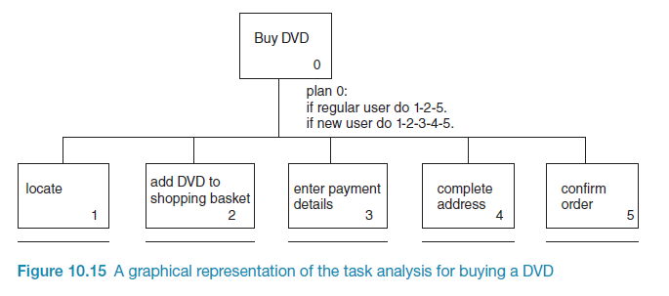
Example Hierarchical Task Analysis (graphical)
Notes:
Graphical notation of an HTA. Here the subtasks are represented by named boxes with itentifying numbers. The hierarchical relationship between tasks is shown using a vertical line. If a task is not decomposed any further then a thick horizontal line is drawn underneath the corresponding box.
Use of HTA has been controversial:
Real tasks are very complex, and task analysis does not scale very well. The notation soon becomes unwieldy, making it difficult to follow
Task analysis is limited in the kinds of tasks it can model. It cannot model tasks that are overlapping or in parallel, not can it model interruptions. Most people work through interruptions of various kinds, and many significant tasks happen in parallel.
Benefits:
It lets you objectively compare alternative desgins, based on the user’s planned tasks and subtasks.
It provides a very good understanding of the interaction at whichever level of abstraction is appropriate.
It support design reuse – again at different levels of abstraction.

Slide 30
Summary
Getting requirements right is crucial
There are different kinds of requirement, each is significant for interaction design
The most commonly-used techniques for data gathering are: questionnaires, interviews, focus groups, direct observation, studying documentation and researching similar products
Scenarios, use cases and essential use cases can be used to articulate existing and envisioned work practices.
Task analysis techniques such as HTA help to investigate existing systems and practices

